Slide 1
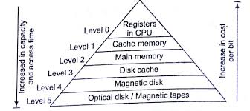
Memory hierarchy
CPU Registers
Accumulator
Data Registers
Program Counter (PC)
Memory Address Register (MAR
Cache memory
buffer between the CPU and the main memory (RAM)
L1 cache
Disk cache
Peripheral cache
STATIC RAM

Slide 2
Memory hierarchy
Characteristics of Memory Hierarchy
Capacity: Move from top to bottom in the Hierarchy, the capacity increases.
Access Time: time interval between the read/write request. Move from top to bottom in the Hierarchy, the access time increases.
Performance: Frequently accessed data is stored in faster memory to improve system performance.
Cost Per Bit: Move from bottom to top in the Hierarchy, the cost per bit increases i.e. Internal Memory is costlier than External Memory.

Slide 3
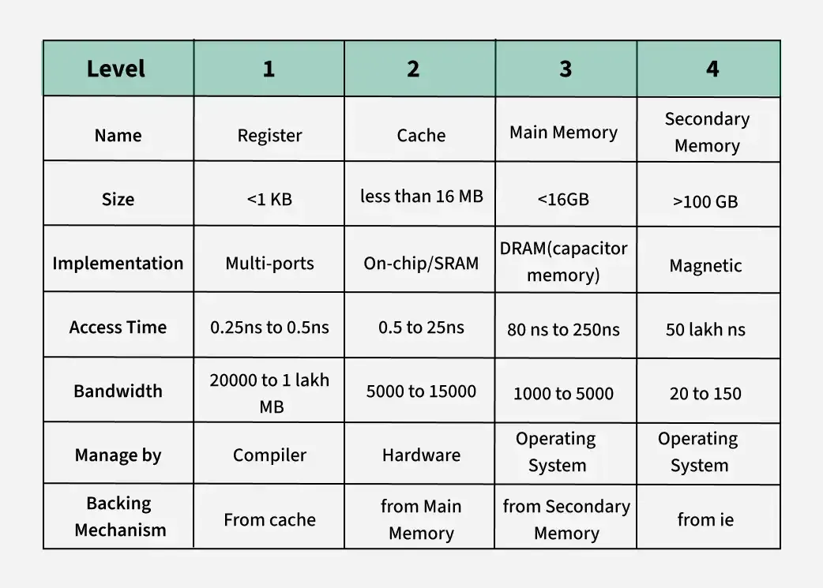

Slide 4
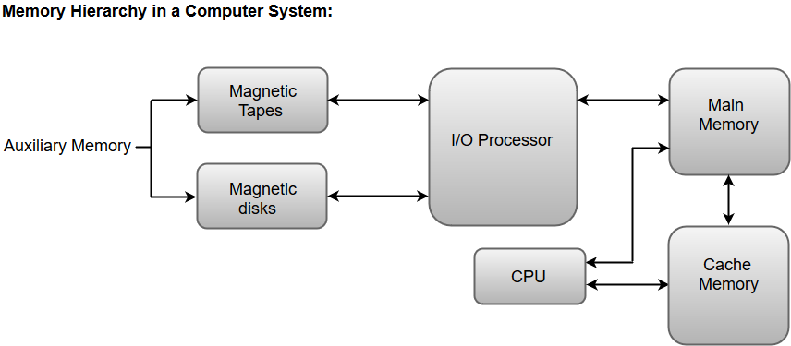
Memory hierarchy
Static RAM: Static RAM stores the binary information in flip flops and information remains valid until power is supplied. Faster and costly
Dynamic RAM: It stores the binary information as a charge on the capacitor. Slower and cheap

Slide 5
Cache memory
Features of Cache Memory
Speed: Faster than the main memory (RAM), helps the CPU access data more quickly.
Proximity: Located at the CPU, often on the CPU chip itself, reducing data access time.
Function: Temporarily holds data and instructions that the CPU is likely to use again soon, minimizing the need to access the slower main memory.

Slide 6
Benefits of Cache Memory
Various benefits of the cache memory are,
Faster access: Faster than main memory. It resides closer to CPU , typically on same chip or in close proximity. Cache stores subset of data and instruction.
Reducing memory latency: Memory access latency refers to time taken for processes to retrieve data from memory. Caches are designed to exploit principle of locality.
Lowering bus traffic: Accessing data from main memory involves transferring it over system bus. Bus is shared resource and excessive traffic can lead to congestion and slower data transfers. By utilizing cache memory , processor can reduce frequency of accessing main memory resulting in less bus traffic and improves system efficiency.
Increasing effective CPU utilization: Cache memory allows CPU to operate at a higher effective speed. CPU can spend more time executing instruction rather than waiting for memory access. This leads to better utilization of CPU’s processing capabilities and higher overall system performance.
Enhancing system scalability: Cache memory helps improve system scalability by reducing impact of memory latency on overall system performance.

Slide 7
Cache memory
What is a Cache Hit and a Cache Miss?
Cache Hit: When the CPU finds the required data in the cache memory, allowing for quick access.On searching in the cache if data is found, a cache hit has occurred.
Cache Miss: When the required data is not found in the cache, forcing the CPU to retrieve it from the slower main memory.On searching in the cache if data is not found, a cache miss has occurred
Performance of cache is measured by the number of cache hits to the number of searches. This parameter of measuring performance is known as the Hit Ratio.
Hit ratio=(Number of cache hits)/(Number of searches)

Slide 8
Types of Cache Memory
L1 or Level 1 Cache: It is the first level of cache memory that is present inside the processor. The size of this memory ranges from 2KB to 64 KB.
L2 or Level 2 Cache: It is the second level of cache memory that may present inside or outside the CPU. The size of memory ranges from 256 KB to 512 KB.
L3 or Level 3 Cache: It is the third level of cache memory that is present outside the CPU and is shared by all the cores of the CPU. Some high processors may have this cache. This cache is used to increase the performance of the L2 and L1 cache. The size of this memory ranges from 1 MB to 8MB.

Slide 9
Difference Between RAM and Cache
Feature | Cache Memory | RAM (Random Access Memory)
Location | Located close to the CPU. | Connected to the CPU via the memory bus.
Purpose | Stores frequently accessed data and instructions. | Serves as the main working memory for the CPU.
Speed | Very fast, with access times in nanoseconds. | Fast, but slower than cache memory, with access times in tens of nanoseconds.
Size | Smaller in size, typically measured in kilobytes (KB) to a few megabytes (MB). | Larger in size, ranging from gigabytes (GB) to terabytes (TB).
Type of Memory | Uses SRAM (Static RAM), which is faster but more expensive. | Uses DRAM (Dynamic RAM), which is slower but more cost-effective.
Accessibility | Extremely fast access times due to proximity to the CPU. | Slightly slower access times compared to cache memory.
Cost | More expensive per unit of memory due to its speed and proximity to the CPU. | Less expensive per unit of memory compared to cache memory.
Hierarchy | Typically organized into multiple levels (L1, L2, L3), with each level increasing in size and latency. | Single level, serving as the primary working memory for the CPU.
Usage | Acts as a buffer between the CPU and main memory (RAM), speeding up data access. | Used for storing data and instructions currently being processed by the CPU.
Capacity | Limited capacity due to its small size and high-speed nature. | Larger capacity, providing ample storage space for running applications and processes.

